Slide 1
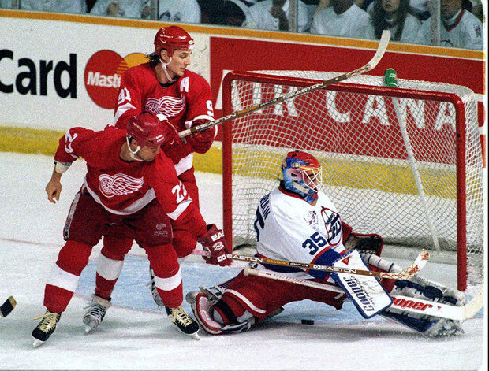


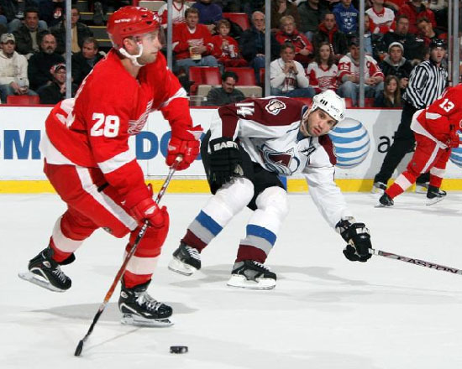

Possible Patterns
Possible Colors
Main Head
Headline Subhead 1
Subhead 2
Navigation
Main Page
Coach
Schedule
News

